Slide 1



Predicting Rain Patterns in Australia
Justin Grisanti

Slide 2
Objectives – 5 Step Model
Obtain a Business Understanding
Understand the Data
Prepare Data for Modeling
Create Models
Generate Results

Slide 3
Business Understanding
Stakeholders:
Australian Bureau of Meteorology
Citizens of Australia
Business Problem
Bureau of Meteorology historically underpredicts rainy days each year
Goals/Value-add
Help the Bureau better inform the citizens of Australia of whether it will rain tomorrow
Provide a model to the Bureau of Meteorology that can be used in conjunction with their own findings to reduce the amount of underpredictions

Slide 4

Data Understanding
Various Weather Data
Dates from 2008 - 2017
Location
Wind Patterns
Sunshine Data
Cloud Data
Humidity
Temperature
Rainfall

Slide 5
Data Preparation
Use data cleaning techniques to prepare data
Outliers
Nulls
Errors
Better data equals a better model

Slide 6
Modeling
Redefine the Problem
Bureau of Meteorology historically underpredicts rainy days each year
Modeling Solution
Our model should minimize false negatives (Type II error)
False Negatives: Days predicted that it won’t rain, and it actually ends up raining
Using Recall to minimize Type II error
Logistic Regression, k-Nearest Neighbors & Decision Trees

Slide 7
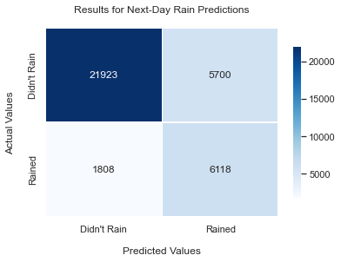
Results
Best Model: Logistic Regression with a weighted-average 79% recall score
Actually Rained Next Day:
Correctly classified that it would rain 77% of the time
Actually Did Not Rain The Next Day:
Correctly classified that it would not rain 79% of the time.
Value: Model prevents False Negatives 80% of the time
Notes:
Input features, will predict if it will rain the next day.

Slide 8
Next Steps:
Find more data with different features (i.e. fog, high/low temperature, more cloud data)
Try different model techniques
Find a way to strengthen our Precision metric (reduce Type I error)

Slide 9
Thank You For Your Time!

